Slide 1
Boyce-Codd (BCNF ) / 3.5 Normal Form

Slide 2
Definition
To eliminate more redundancy from the table the relation should be normalized to higher level. BCNF is the advance version of 3NF. It is stricter than 3NF.
A relation is said to be in BCNF if it is in
i) 3NF
ii) A table is in BCNF if every functional dependency X→Y, X is the super key of the table.

Slide 3
Example 1
R (ABC)
FD: A→B, B→C, C→A
1) CK: A, B, C
2) Prime Attributes: A, B, C
3) Non-Prime attribute: Nil
4) Now, check the FD separately
A→B (it is in BCNF as LHS is a CK)
B→C (it is in BCNF as LHS is a CK)
C→A (it is in BCNF as LHS is a CK)
LHS of each given functional dependency is a candidate key..
So, the HNF is BCNF

Slide 4
R(PQR) FD: PQ→R; R→Q
Example 2
Check for BCNF
Check for 3NF
CK: PQ and PR
PA: P, Q, R NPA: Nil
Check for the BCNF:
PQ→R
PQ is CK, so it is in BCNF
b) R→Q
R is not CK so, it is not in BCNF
Overall the relation is not in BCNF
CK: PQ and PR
PA: P, Q, R NPA: Nil
All the attributes are prime attributes , so the given condition is not satisfied. NPA→NPA
So, HNF is 3NF

Slide 5
R (ABCDE) FDs: A→BCDE; BC→ACE; D→E
Example 3
Check for BCNF:
Check for 3NF:
CK: {A}, {BC}
Prime attributes: A, B, C
Non-Prime attributes: D,E,
Check for each dependency individually
A→BCDE {LHS is CK so it is in BCNF}
BC→ACE {LHS is CK so it is in BCNF}
D→E {LHS is not CK so it is not in BCNF}
Therefore, the relation is not in BCNF.
A→BCDE {LHS is CK so it is in 3NF}
BC→ACE {LHS is CK so it is in 3NF}
D→E {D & E both are NPAs so it is not in 3NF}.
Therefore, the relation is not in 3NF.
Check for 2NF:
A→BCDE {LHS is CK so it is in 2NF}
BC→ACE {LHS is CK so it is in 2NF}
D→E {LHS are NPAs so it is in 2NF}.
Therefore, the HNF is 2NF.

Slide 6
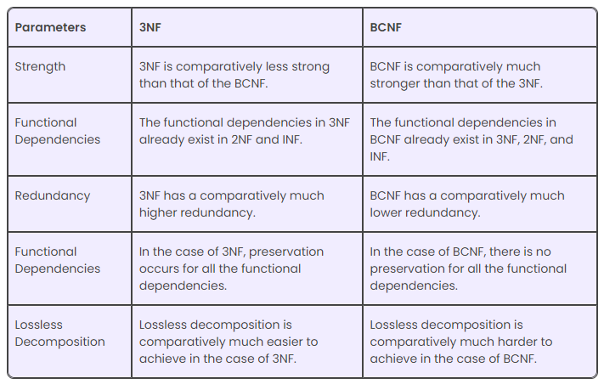
Difference between 3NF and BCNF

Slide 7


